Slide 1


UNIVERSITY OF ENGINEERING & MANAGEMENT, KOLKATA
Course Name : Operating System Laboratory

Slide 2


UNIVERSITY OF ENGINEERING & MANAGEMENT, KOLKATA
Day 8
Lab Assignments:
1. Write a shell script, which reports names and sizes of all files in a directory (directory should be supplied as an argument to the shell script) whose size exceeds 100 bytes. The filenames should be printed in decreasing order of their sizes. The total number of such files should also be reported.
2. Write a shell script that shows the names of all the non-directory files in the current directory and calculates the sum of the size of them.
3. Write a shell script to list the name of files under the current directory that starts with a vowel.
4. Write a shell script which receives two filenames as arguments and checks whether the two file‟s contents are same or not. If they are same then the second file should be deleted.

Slide 3
UNIVERSITY OF ENGINEERING & MANAGEMENT, KOLKATA
Day 9
Lab Assignments:
1. A file called list consists of several words. Write a shell script which will receive a list of filenames, the first of which would be list. The shell script should report all occurrences of each word in list in the rest of the files supplied as arguments.
2. Write a shell script which deletes all lines containing the word UNIX in the files supplied as arguments to this shell script.
3. Write a shell script which would receive a log name during execution, obtain information about it from password file and display this information on the screen in easily understandable format.
4. Write a shell script, which will receive either the filename or the filename with its full path during execution. This script should print information about the file as given by ls –l command and display it in an informative manner.

Slide 4
UNIVERSITY OF ENGINEERING & MANAGEMENT, KOLKATA
#! /bin/sh #Purpose: To print the name of all files in a directory whose size exceeds 100 bytes alongwith total number of such files. # USAGE: sh file100byte.sh directoryname
if test $# -ne 1
then
echo “Please give a directory name and try again”
exit
fi
cd $1 find -size +100b | sort –nr
echo “Total number of such files:”
find -size +100b | grep -c “.*”
#end of script

Slide 5
UNIVERSITY OF ENGINEERING & MANAGEMENT, KOLKATA
Solution: 3)
3) #! /bin/sh #Purpose: To list the files starting with a vowel. # USAGE : sh filevowel.sh (no arguments required)
echo “Required files are:”
ls | grep “^[aeiou]”
#end of script 4

Slide 6
UNIVERSITY OF ENGINEERING & MANAGEMENT, KOLKATA
Solution: 4)
4) #! /bin/sh #Purpose: To compare two files and delete the second file if they are equal. # USAGE: sh filecomparedel.sh file1 file2
if test $# -ne 2
then
echo “Please give two filenames.”
exit
fi
cmp -s $1 $2
if test $? -eq 0
then echo “$1 and $2 are same”
rm $2
else
echo “$1 and $2 are not same”
fi
#end of script

Slide 7
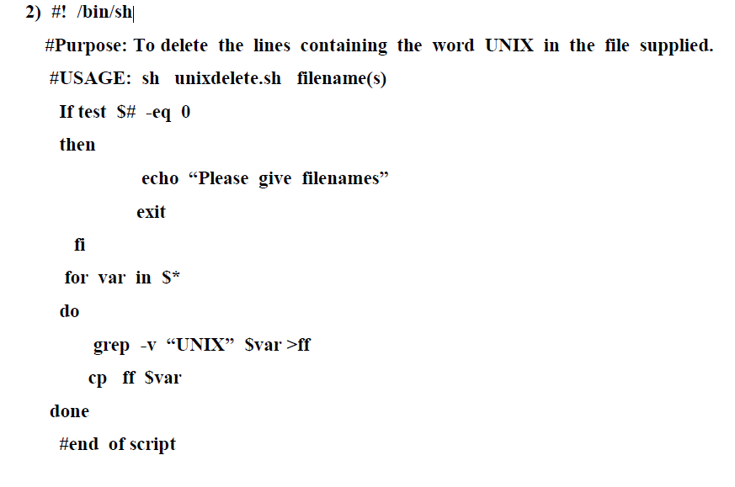
UNIVERSITY OF ENGINEERING & MANAGEMENT, KOLKATA
Solution: (LAB) 2 Day 9)

Slide 8
UNIVERSITY OF ENGINEERING & MANAGEMENT, KOLKATA
find command in Linux
The find command in UNIX is a command line utility for walking a file hierarchy. It can be used to find files and directories and perform subsequent operations on them.
It supports searching by file, folder, name, creation date, modification date, owner and permissions.
$ find [where to start searching from] [expression determines what to find] [-options] [what to find]
Options :
-exec CMD: The file being searched which meets the above criteria and returns 0 for as its exit status for successful command execution.
-ok CMD : It works same as -exec except the user is prompted first.
-inum N : Search for files with inode number ‘N’.
-links N : Search for files with ‘N’ links.
-name demo : Search for files that are specified by ‘demo’.

Slide 9
UNIVERSITY OF ENGINEERING & MANAGEMENT, KOLKATA
Set command in Linux
Set command: It is used to set or unset specific flags and settings( determines the behavior of the script and helps in executing the tasks without any issue.) inside the shell environment.
Syntax:
set -options argumentsThe set command supports the following options:
OptionDescription
-a use to mark variables that are created or modified or created for export.
-b use to notify the termination of the job.
-e use to exit when the command exits with a non-zero status.
-f it disables the file name generation known as globbing
’.
-u It treats unset variable as an error during substitution
-v It prints the shell input lines
–x It prints the commands and their arguments in the same sequence as they got executed

Slide 10
UNIVERSITY OF ENGINEERING & MANAGEMENT, KOLKATA
Set command in Linux
Set command: set assigns it’s argument to the positional parameters
Example :
#!/bin/bash
set `date`
Echo “ the year of system = $6”
Echo “ the month of system = $4”
Method 1: Using -mtime(modification time) attribute of find command
To list files whose timestamp has been changed more than n days ago – mtime +n
To list files whose timestamp has been changed less than n days ago – mtime – n
To list files whose timestamp has been changed exactly n days ago – mtime n
Method 2: Using atime (File access) attribute of the find command.
It is an access timestamp, and it tells us the last time a file was read or accessed which means an application was used to open the file and read its contents.
To list files whose timestamp has been changed less than n days ago – atime – n
To list files whose timestamp has been changed exactly n days ago – atime n

Slide 11
UNIVERSITY OF ENGINEERING & MANAGEMENT, KOLKATA
Examination code is K17014572022000027 CSE Section A-B-C-D
Examination code is K17014572022000028 CSE AIML Section A
Examination code is K17014572022000029 CSE IoT Section A
Examination code is K17014572022000031 CSBS Section A

Slide 12

UNIVERSITY OF ENGINEERING & MANAGEMENT, KOLKATA
Thank You

